Slide 1
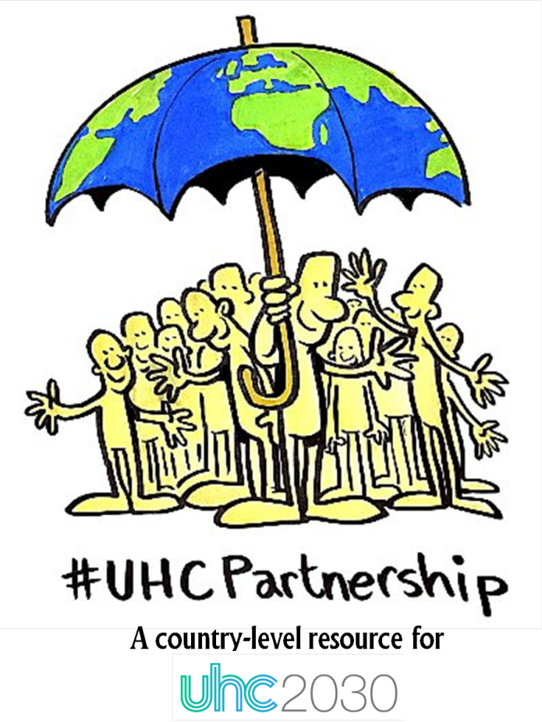
Supporting policy dialogue for health planning and health financing
Brisbane, October 25th 2017
A realist intervention theory of the Universal Health Coverage Partnership
E. Robert, D. Porignon, D. Rajan, V. Ridde
Notes:
Les questions qui servent de fil conducteur : In what respects and why have realist methods been useful?

Slide 2
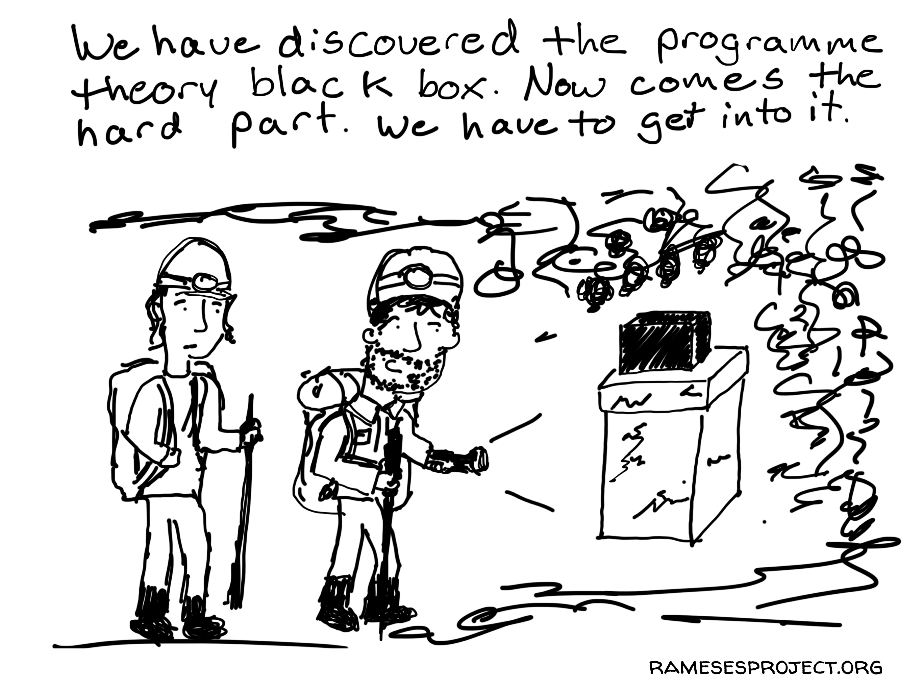
Objectives of the presentation
To present the intervention theory as the first output of the research
To reflect on the value of the intervention theory and the research process

Slide 3
Context
Universal health coverage (UHC) as a blueprint to strengthen health systems in developing countries
Policy dialogue as a promising governance tool: process targeting both the technical and policy aspects of the problem being discussed, involving evidence and sensitive policy discussions, in which a wide range of stakeholders participate, with a concrete objective, such as the development of a plan or strategy
UHC-Partnership to support policy dialogue for health planning and health financing in about 30 countries
Typical soft intervention: how to account for outcomes in different settings with major contextual influences?

Slide 4
Method
For the realist evaluation
For the intervention theory
Objective: to better understand if the UHC-Partnership can contribute to strengthen policy dialogue, how and in what contexts
Multiple case study (Togo, Liberia, Burkina Faso, Niger, DRC, Cape Verde)
Qualitative research
1st round:
Documentation
Formal discussions with implementers
2nd round :
Observations
Interviews with key informants
Literature review
3rd round :
Discussions with implementers

Slide 5
UHC-P realist intervention theory
Approach (SOFT)
Components of support
(HARD)
Results
Mécanismes
Outcomes
Goal
MAKE IT HAPPEN
Mutual understanding of values, agendas, and needs of stakeholders
Support to policy dialogue
Knowledge and resources production
Flexibility
M (?)
Fed by knowledge
Inclusive and participatory
Led by MoH
Formulation of robust and comprehensive health policies, strategies and plans
Ad hoc technical expertise
Contribution
Policy dialogue
Trust in a structured and transparent process
TRIGGERS
Responsiveness
Strengthening of governance towards Universal Health Coverage
Support to institutionalisation of policy dialogue for health planning and financing
Stakeholders’ buy-in of decisions
Alignment of stakeholders
Capacity building of MoH
On-going support
M (?)
MAKE IT HAPPEN
MoH ownership of the process
Proactiveness
Training
Strengthened leadership of MoH

Slide 6
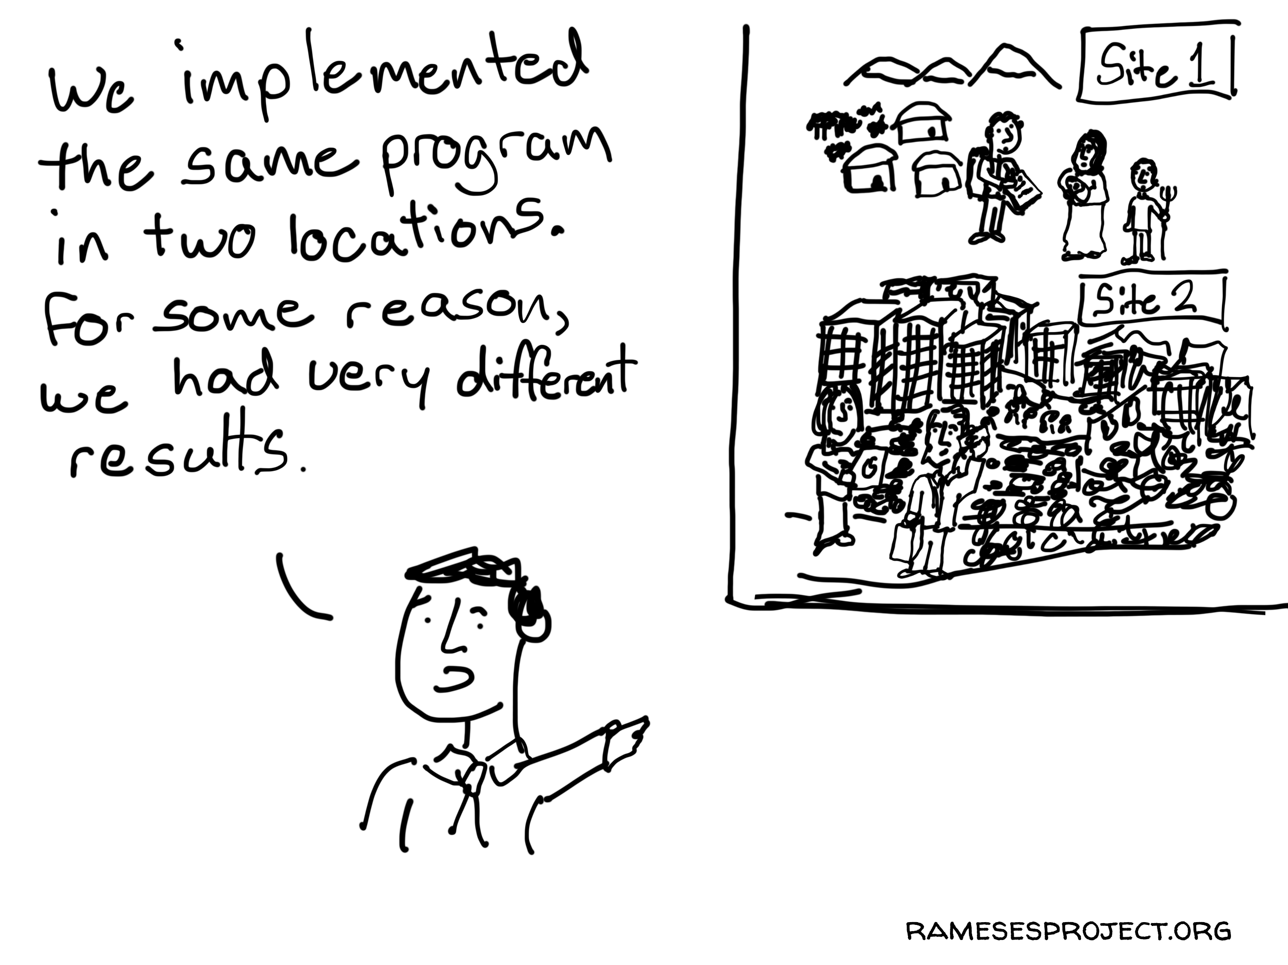
The researchers’ perspective (1)
For the research team
Provides a common understanding of the intervention
Becomes a framework to look at national experiences
Exposes the two level analysis of the research
Challenges:
The IT does not depicts reality. It is a way to look at reality.
How to move away from this “typical” representation?
Social sciences and anthropology researchers unfamiliar with IT

Slide 7
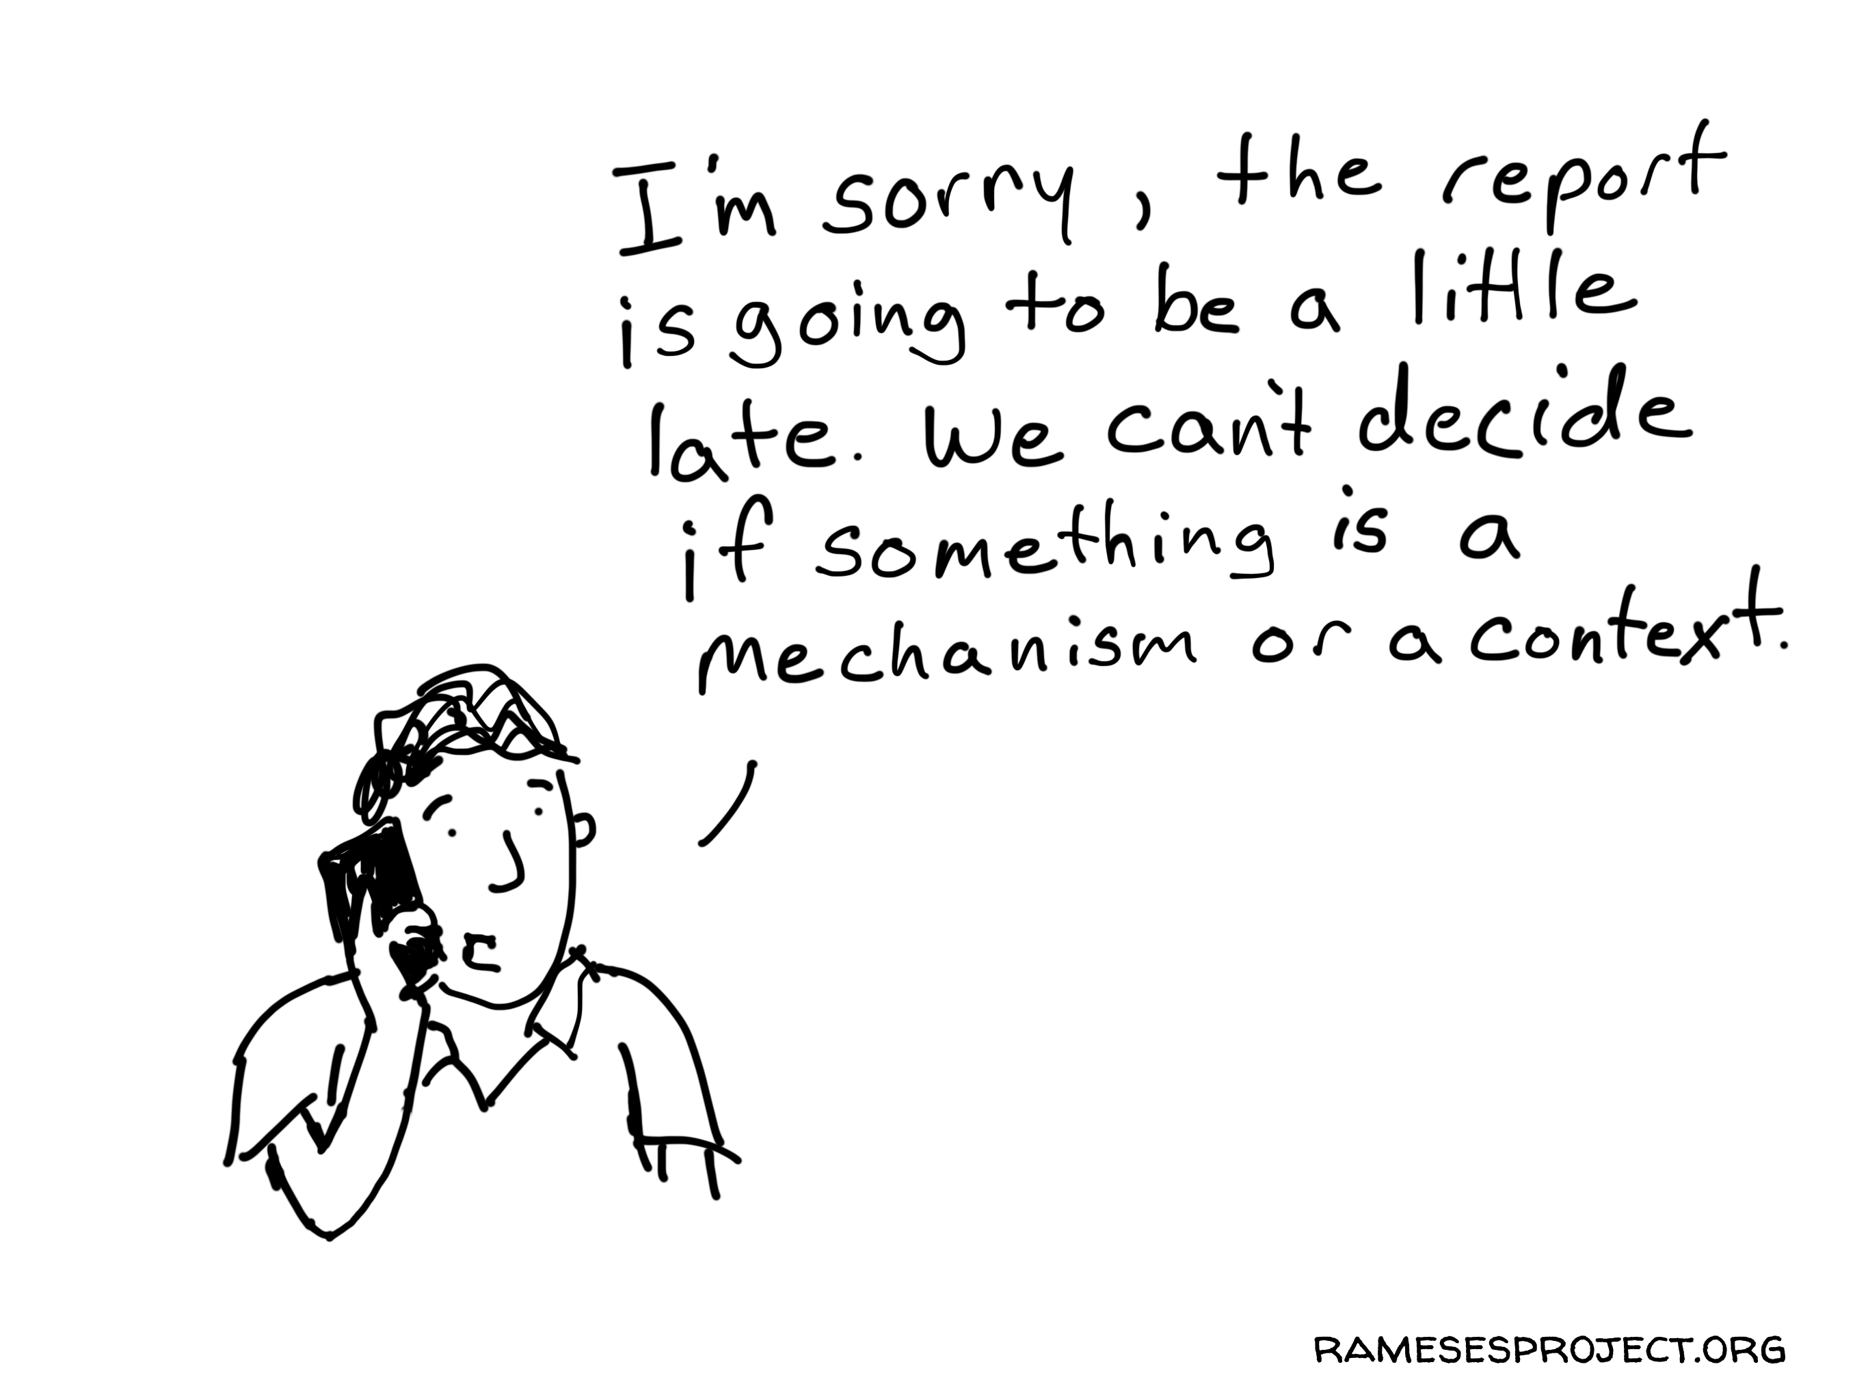
The researchers’ perspective (2)
For commissioners & implementers
A way to send out messages :
Ensure a common understanding of the intervention
Demonstrate the complexity of the analysis
Illustrate the multiple causal pathways and far-reaching and long term expected outcomes
Lower expectations

Slide 8
The implementers’ perspective (Feedback from the field)
The process
The intervention theory
Allowed for clarifications about both the intervention and their role
Provoked discussions and triggers a reflective process among implementers on their role
Raised awareness about the research process
Provided - in a structured and synthesized manner - an illustration of their role
Gave a sense to action
Why?
No time to step back when in the job
Loss of sight of the objectives
Possible confusion on role in the UHC-P vs. traditional role / way of doing thing (technical support to MoH)

Slide 9
The commissioner’s perspective
Complex intervention on policy dialogue at country level
The "million lives saved" syndrome
The bureaucratic approach of donors to evaluation
The attribution nightmare
Confirm the perceptions of policy-makers
Demonstrate actual outcomes of the intervention: WHO's role and mandate as an institution
The real life of the process over time
Identification of the mechanisms

Slide 10
Several ways at looking at policy dialogue & UHC-Partnership
 | Normative evaluation | SOM (EU) | Research on policy dialogue | Realist research
Mandate | Results/Objectives | Results/objectives | Perceptions of policy dialogue in the field | Context & mechanisms
Added value | Valued by donors/stakeholders | Responds to donor requirements | Set the scene of policy dialogue in SSA | Flexible Key actionable factors
Limits | Mechanistic attribution "Governed by numbers" | No expertise in health systems « A côté de la plaque » | Not about the UHC-P No attribution | Does it work? Too sensitive to contexts?

Slide 11
Lessons learnt
The intervention theory as an efficient tool to:
Reflect on the intervention
Structure the research process
Building the intervention theory as a necessary step to :
Ensure a shared understanding among researchers, implementers and commissioners about the research object, the intervention, and the research process
Challenges of collaboration: symbolic vs. instrumental use of research findings?

Slide 12
Emilie Robert is a postdoctoral researcher at the Research Institute of McGill University Health Centre (Montreal, Canada). She holds a scholarship from the Canadian Institute of Health Research.
Contact: emilie.robert2@mail.mcgill.ca
Twitter: @emilie_robert_
Denis Porignon is a health policy specialist at the Department of Health Systems Governance and Financing at WHO (Geneva, Switzerland).
Contact: porignond@who.int
Twitter: @DenisPorignon
Dheepa Rajan is a health policy specialist at the Department of Health Systems Governance and Financing at WHO (Geneva, Switzerland).
Contact: rajand@who.int
Twitter: @Dheepa_Rajan
Valéry Ridde is a professor at the School of Public Health at Montreal University (Canada).
Contact: valery.ridde@umontreal.ca
Twitter: @ValeryRidde

