Slide 1
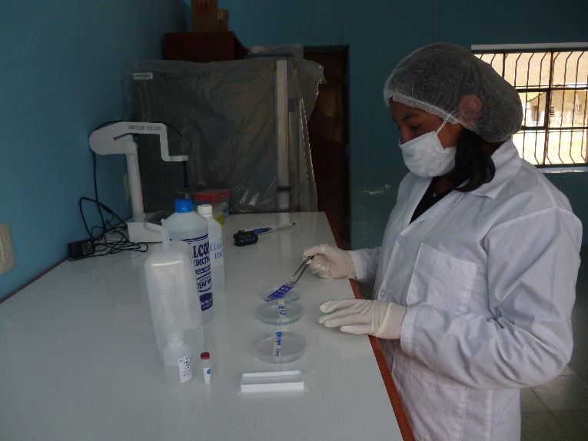
Hernán Cucho¹, César Ordoñez¹, Enrique Ampuero¹,
Nancy Huanca¹, Wini Quispe¹, Melisa Mendoza¹, Ruth Ccalta¹, Christian Hanzen²
¹Professional School of Animal Science, National University of San Antonio Abad of Cusco
²Faculty of Medicine Veterinary, Department of Theriogenology, University of Liege
Fragmentation index of DNA sperm in llama semen
(Lama glama)
DNA fragmentation of spermatozoa is an important indicator of seminal quality and fertility. The quality of the genetic information contained in the DNA molecule transmitted by the spermatozoa is important for the proper development of the embryo (Schulte et al., 2010).
Our study analyze the fragmentation of DNA sperm in llama semen collected by post-copula vaginal aspiration.
Goal
Procedures
4 llamas collected three times (n=12).
Spermatozoa with intact ADN
Spermatozoa with DNA fragmentation
Results
Variable | n | Mean | ± D.S | C.V (%)
Volume (ml) | 12 | 1.3 | 0.8 | 61.5
Motility (%) | 12 | 12.3 | 2.0 | 16.4
Concentration (10⁶ spz) | 12 | 183.5 | 52.3 | 28.5
Vitality (%) | 12 | 64.7 | 11.4 | 17.6
Sperm membrane functionality HOS (%) | 12 | 64.9 | 11.6 | 17.9
Sperm DNA fragmentation index (Halomax system ®) | 12 | 11.6 | 13.3 | 114.4
Conclusion
The values of the different parameters indicate the high quality of the collected semen
This research was sponsorised
by the Canon fund UNSAAC
Schulte et al., 2010. J Assist Reprod Genet. 27:3–12

