Slide 1
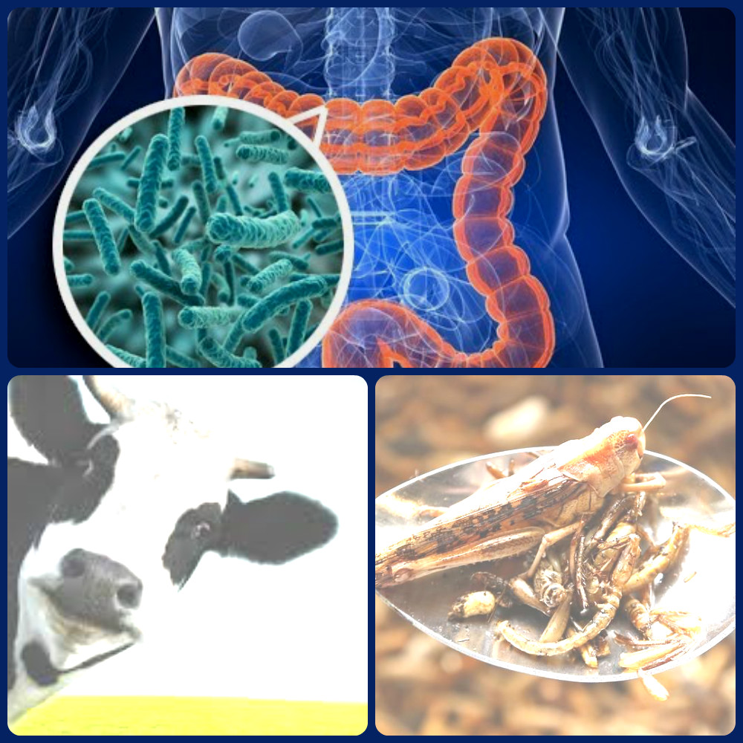
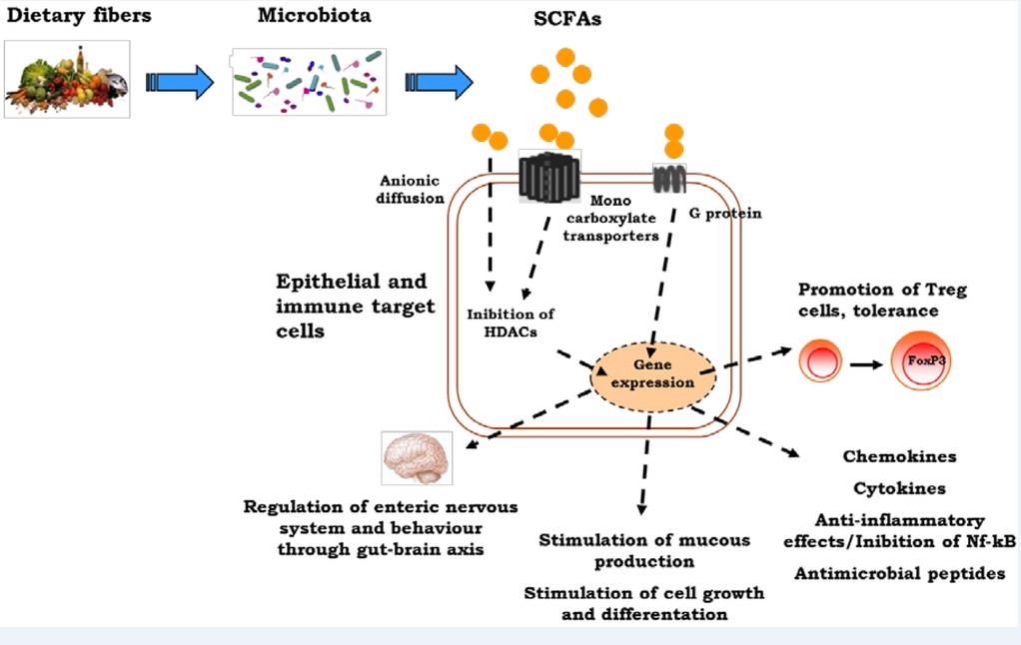
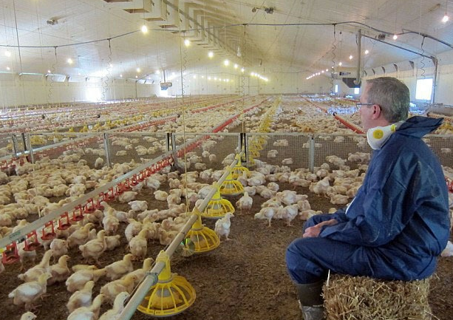
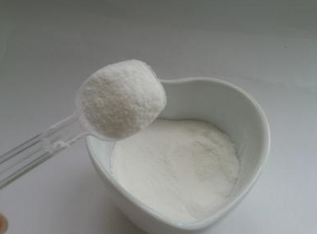
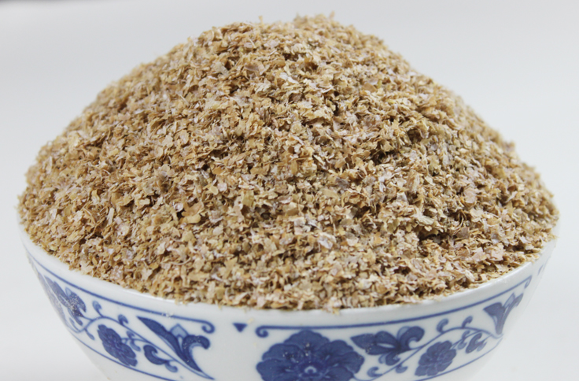
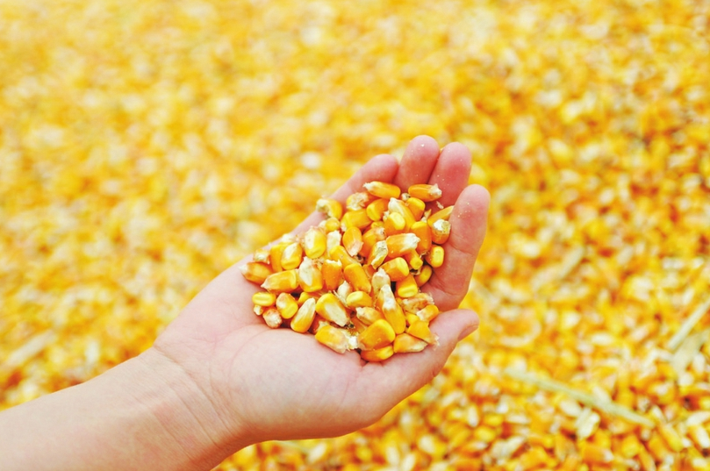
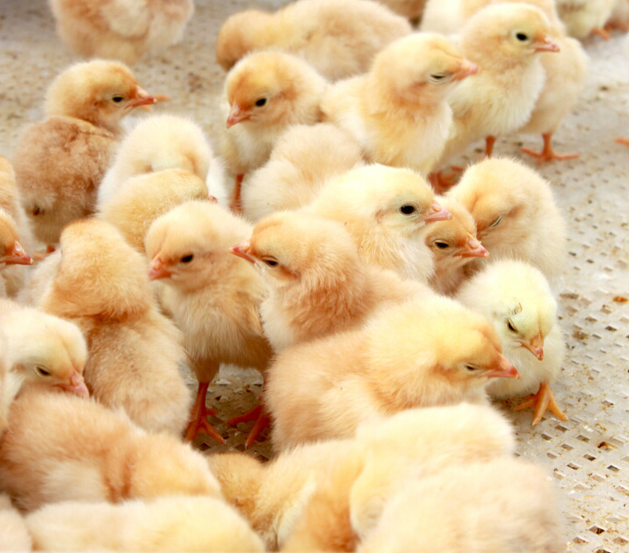
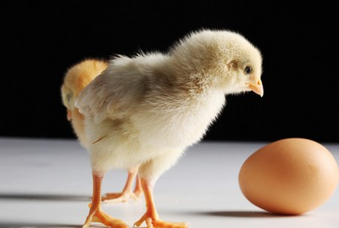
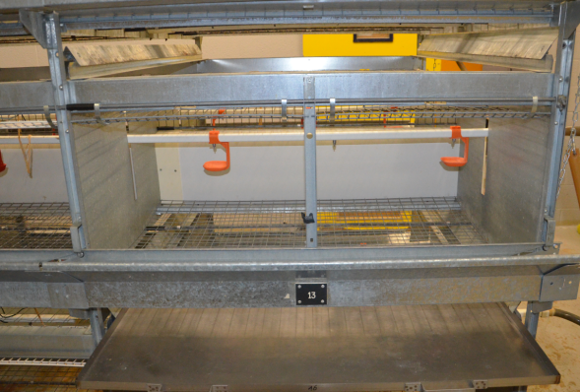
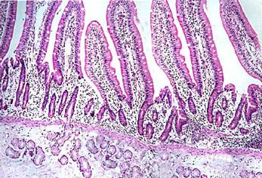
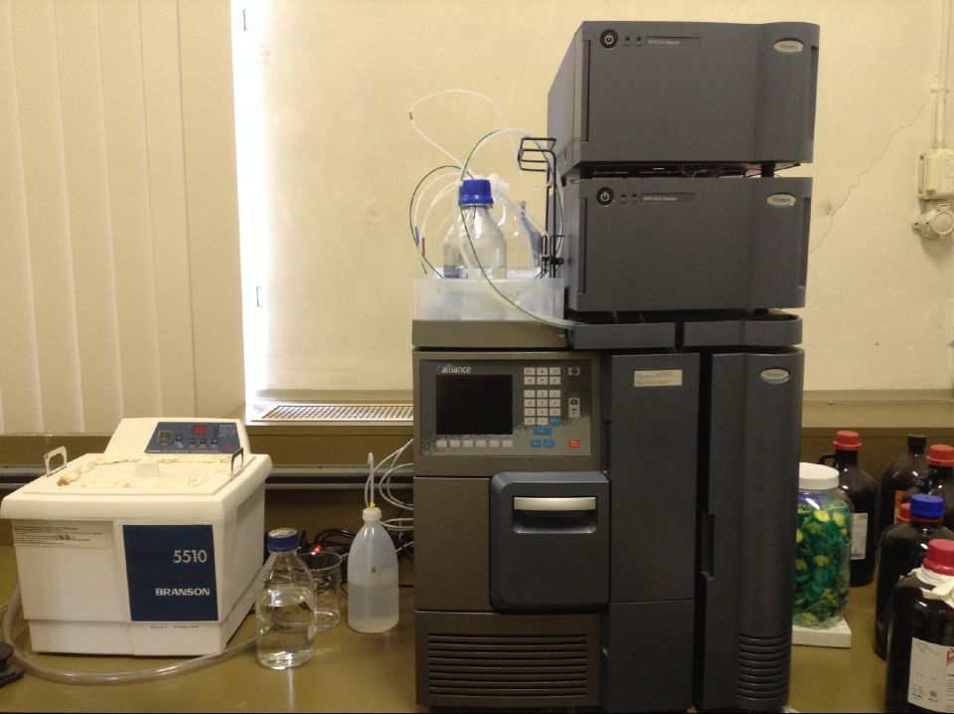
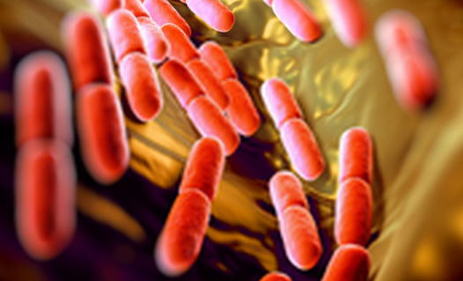
TERRA day – May 20th 2016
Optimizing performance and health in poultry by dietary strategies :
Focus on gastrointestinal ecophysiology
B. Li#, F. Huart #, J. Leblois#, Y. Beckers#, J. Bindelle#, N. Everaert#
#Precision livestock and Nutrition Unit, Gembloux Agro-Bio Tech, University of Liège, Passage des Déportés, 2. B-5030 Gembloux, Belgium
Introduction
Function of gastrointestinal tract (GIT):
Digestion and absorption of nutrients
Defence against pathogenic micro-organisms, toxins and other harmful substances
Bacteria in GIT acting as an additional defence barrier
The main work in our lab:
Investigate effect of some dietary fiber (e.g. inulin and wheat bran) on gut health and animal performance
Optimize nutritional quality of feed ingredients (e.g. corn’s dryness ) with the aim of improving animal performance and digestibility
FEEDING THE FUTURE
Inulin
Wheat bran
Corn
Research
Project.1: Effect of inulin and wheat bran on the intestinal health and animal performance
Project.2: Effect of corn’s dryness on the performance and digestibility of broilers
Materials and methods
Broilers: 960 male Ross 308
Materials and methods
Broilers: Ross 308
4% Inulin
Experiment.1: Performance
Broilers have been fed
60% corn (humidity 29%, dried by 3 different temperatures)+40% chicken feed
60% corn (humidity 36%, dried by 3 different temperatures)+40% chicken feed
Broilers
10% Wheat bran
4% Inulin+10% Wheat bran
Control
Experiment.2: Digestibility
Broilers have been force fed a diet using 2 kind of corn (humidity 29% and 36%, dried by 3 different temperatures. Water: Corn=1.1:1)
After starter, every group was equally divided in two：
Half: Dietary treatment
Half : Control diet
Indicators
Performance
Digestibility
Villus height/Crypt depth
Volatile Fatty Acids
Intestinal microorganisms
Acknowledgements
COSUCRA/CRAw/ TERRA/ AgroBioChem/
Precision Livestock and Nutrition Unit,
Contact: bli@student.ulg.ac.be

