Slide 1

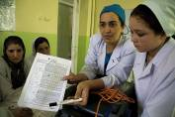
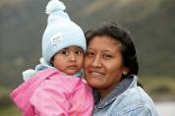
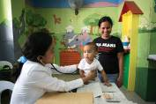
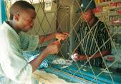
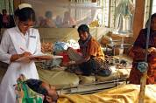

Health systems governance for UHC:
from global policy to operations in countries
EU-Luxembourg / WHO Universal Health Coverage Partnership
Dr. Denis Porignon – WHO/HQ/HGF
Montreal, November 2016

Slide 2
I. Health Systems, UHC, SDGs

Slide 3
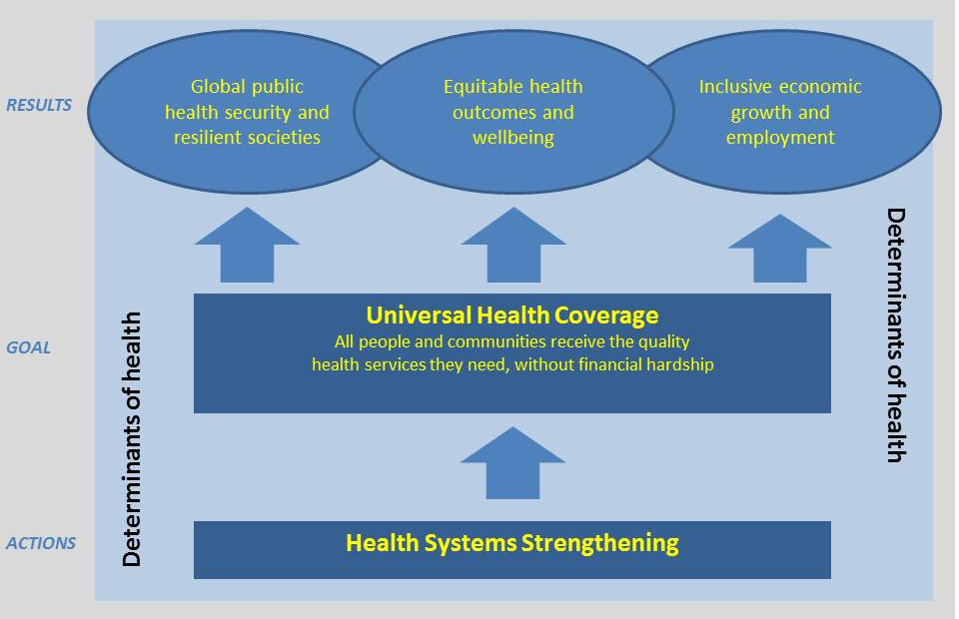
A new WHO Framework for UHC as part of the SDGs
WHO, 2016
Notes:
The Sustainable Development Goals (SDGs) emphasize Universal Health Coverage (UHC) as one of its key target (Target 3.8).
Universal Health Coverage (UHC) will only be achieved by 2030 if consistent and comprehensive health system strengthening (HSS) efforts take place immediately.
Strong health systems are also essential to ensure both individual and global public health security.

Slide 4
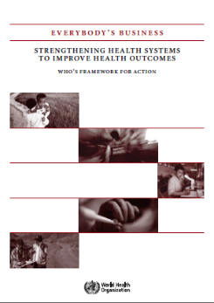


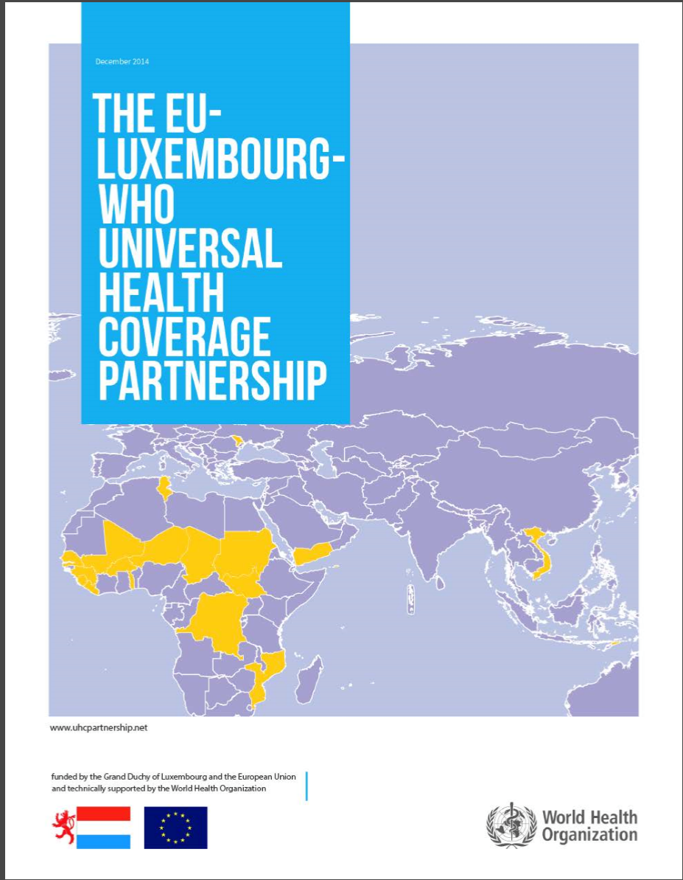
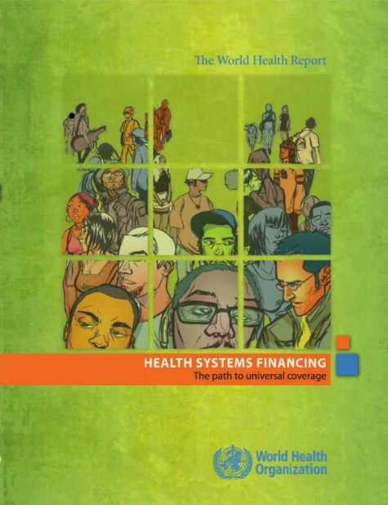

Timely - renewed interest for HSS
WHO
Multi & Bi-laterals
UHC
2030
G7
Ise- Shima
Declaration
May 2016
Germany
Healthy
Systems
Healthy
Lives
Roadmap

Slide 5
Health Systems Strengthening is about leveraging domestic resources
The minimum additional investment required in the health sector for countries to attain the SDGs by 2030 amounts US$55 billion per year
Between US$35-40 billion of these US$ 55 Billion per year must be spent on HSS efforts
In 2013, ODA for funding HSS reached US$ 2.3 Billion or only 6% of total ODA for health, whereas funding for disease-specific programs (e.g. fighting HIV/AIDS or malaria) amounted to US$34 billion
Even in fragile states, about 75% of total health spending come from domestic sources (95% in middle income countries)
However, in most fragile and low income countries OOP is unacceptably high (50% of THE): domestic resources are not optimally distributed
Source: Based on WHO’s work as part of the Lancet Commission Global Health 2035; WHO analyses prepared for the 3rd FfD Conference and HSS roadmap; Institute for Health Metrics and Evaluation (IHME) estimates for 2013 http://vizhub.healthdata.org/fgh/; WHO Global Health Expenditure Database (GHED) 2013 (http://apps.who.int/nha/database, accessed 15 February 2016)
Notes:
The global HSS gap (US$ 40 Billion/year) demands additional resources and optimisation of existing resources
This is particularly pressing at the domestic level: even in fragile states and the least developed countries, domestic sources contribute to about 75% of total health spending. While the call to mobilize and reallocate domestic sources to finance HSS is strong, there remains a prominent role for external assistance in supporting countries to better manage and efficiently use current and future domestic resources

Slide 6
Therefore..
  A critical issue is about channelling funding in the right direction
  There is a need to bring back governance in the domestic space
  There is a need to build or strengthen institutions that will allow this
  But one size doesn't fit all... => there is a need for a tailored approach

Slide 7
FIT for purpose… country contexts matters!
Strategy 1: Building Health system Foundations in least developed and fragile countries
Strategy 2: Strengthening health system Institutions in least developed countries where foundations are already in place
Strategy 3: Supporting health system Transformation in countries with mature health systems
A right combination of “essential investments” (strategy 1) and “software support" (strategies 1 to 3) is needed to build strong health systems and achieve results in UHC and health security
Notes:
Please note that focus of this presentation is strategy 1 and 2

Slide 8
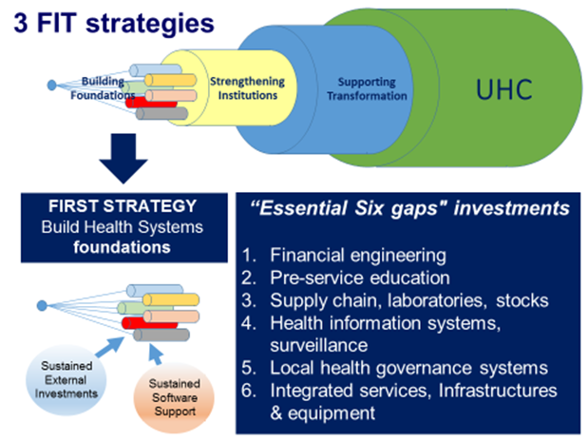
Health Systems Contexts and the WHO FIT strategies

Slide 9
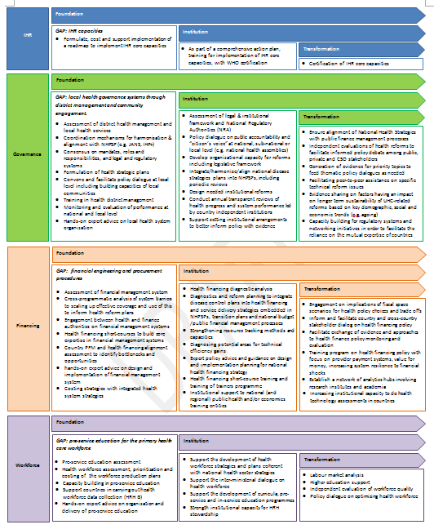
Tailored strategies, tailored products
Governance
Foundation
Assessment of district health management and local health services
Coordination mechanisms for harmonisation & alignment with NHPSP (e.g. JANS, IHP+)
Consensus on mandates, roles and responsibilities, and legal and regulatory systems
Formulation of health strategic plans
Convene and facilitate policy dialogue at local level including building capacities of local communities
Training in health district management
Monitoring and evaluation of performance at national and local level
Hands-on expert advice on local health system organization
Institution
Assessment of legal & institutional framework and National Regulatory Authorities (NRA)
Policy dialogue on public accountability and “citizen’s voice” at national, sub-national or local level (e.g. national health assemblies)
Develop organizational capacity for reforms including legislative framework
Integrate/harmonise/align national disease strategies plans into NHPSPs, including periodic reviews
Design needed institutional reforms
Conduct annual transparent reviews of health progress and system performance led by country independent institutions
Support setting institutional arrangements to better inform policy with evidence
Transformation
Ensure alignment of National Health Strategies with public finance management
Independent evaluations of health reforms to facilitate informed pluralistic policy debate
Generation of evidence for priority topics to feed thematic policy dialogues
Facilitating peer-to-peer assistance on specific technical reform issues
Evidence sharing on factors having an impact on longer term sustainability of UHC-related reforms
Capacity building for regulatory systems and networking initiatives in order to facilitate the reliance on the mutual expertise of countries

Slide 10
II. More concretely?

Slide 11
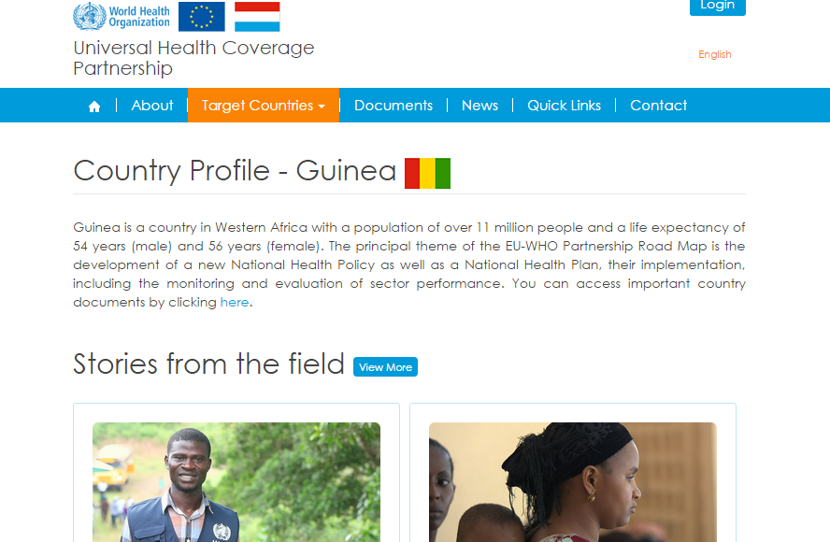

The EU-Luxembourg / WHO UHC Partnership
Supporting Policy Dialogue
on National Health Policies, Strategies and Plans for Universal Health Coverage
[30 countries 2012-2018]
Information resources
www.uhcpartnership.net
+
www.who.int/healthsystems/publications/nhpsp-handbook/en/

Slide 12
The UHC-partnership in 2011
SDGs, WHA resolutions on PHC, HSS, PCC, UHC,
IHP+ and UHC 2030
EU concern
WHO roles in countries
GD Luxembourg's involvement (2012)

Slide 13
Support to countries 2011-2018
3 phases of countries –
in 30 countries
Support to policy dialogue
Complexity
Variability needs, systemic interactions, possible results
("open" uncertainty)
Flexibility
Contribution vs attribution
“set of formal and informal
exchanges aimed at
facilitating policy change,
influencing policy design
and fostering further
processes for decision-making
where stakeholders of the
different health system levels
participate and contribute”
(WHO, 2016)

Slide 14
Major areas of work
AREAS of ACTIVITIES
LEVELS of ACTIVITIES
TYPE of ACTIVITIES
MoH Institutions Capacity Building
Major focus
Strategic National Planning
National level
Aid Effectiveness – IHP+
National Policy/Political
objectives
Decentralization
Laws & regulation
Provincial level
Strategic work
Monitoring & Evaluation
Health Financing
Support for more technical areas of work
(Health Accounts, HIS, Drug pricing,…)
Financial Management Systems
Local level
Human Resources for Health
Health Information Systems
Medicines

Slide 16
FIT
Institutional coherence of the
different agencies
of the health sector
in Morocco (ANAM,…)
Health System Development towards UHC
Health Financing Strategy
in Burkina Faso
HS Annual reviews
Building
Foundations
Strengthening
Institutions
Supporting
Transformation
UHC
Health Accounts
public accountability
and “citizen’s voice”
in Tunisia
HRH strategy in Sierra L.
PHC and Hospital Reform in Moldova

Slide 17
Demonstrating results [ex: DRC]
UHC partnership support: Technical support and funding
The need to coordinate an increased number of actors and align increased donor inflows.
All coordination structures at the different levels were reviewed: their membership, terms of reference and reporting mechanisms.
As a result of the UHC partnership
Problem
Improved sector coordination which will lead to comprehensive planning and rationalised resource allocation.
Restructuring of the central level MoH
UHC partnership support: Technical support to review all coordination structures, their ToR and membership (ER 6)
Strengthened the partner coordination unit
Improved alignment to country priorities
=> Realist research study ongoing in 6 countries in collaboration with University of Montreal and McGill University: Togo, Liberia, DRC, Cabo Verde, Burkina Faso, Niger

Slide 18
Realist resarch
Objective: to identify the contexts in which the UHC-P, through WHO support, can or cannot
  Act as a broker or convener, creating synergy among the actors involved in policy dialogue and health planning
  Play its role as technical expert, orienting policy dialogue and health planning in accordance with available evidence and equity principles
  Support ministries of health in their leadership and stewardship functions
Pilot study conducted in Togo in early 2016
HQ-AFRO-WCO joint selection of 6 countries for the study: Togo, Liberia, DRC, Cabo Verde, Burkina Faso, Niger

Slide 19
III. Focus / areas for research
Strong health systems contribute to Universal Health Coverage and health security, health outcomes, growth & employment
SDG 3 will only be realized with consistent, immediate, and comprehensive HSS efforts
A reallocation of international aid and a reprioritization of domestic health spending towards HSS is needed
An improved global governance mechanism, UHC 2030, is created and is likely to play a significant role in the coming years.
Room for better collaboration/integration with Emergency programmes

